Slide 1

Market Analysis – Federal Hockey League Expansion
Prepared by Adam Bakopolus
August 21st, 2021

Slide 2


Slide 3
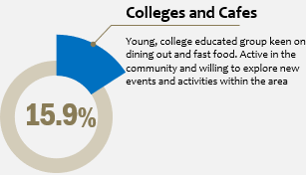
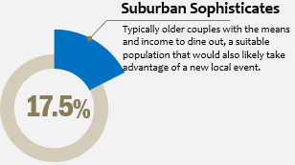
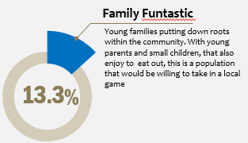
Hays, Kansas has a favorable population demographic
Source: Gale Business DemographicsNow Mosaic Population Summary Index Reports

Slide 4
Population dynamics and growth for Hays look promising
Source: 2019 American Community Survey 5-year estimate data vis CensusReporter.org

Slide 5


Slide 6
Hays has ideal location and infrastructure for an expansion site

Slide 7
Factors Against Runner-Up Location: Alpena, Michigan

Slide 9
Sources
Mosaic Population Summary Index Reports via Gale Business DemographicsNow, accessed August 5th, 2021
Complete Demographic Summary Report via Gale Business DemographicsNow, accessed August 5th, 2021
2019 American Community Survey via CensusReporter.org, accessed August 5th, 2021
The Alpena News, “Tourism numbers show increase for Alpena County”, accessed August 14th, 2021
https://www.thealpenanews.com/news/local-news/2017/08/tourism-numbers-show-increase-for-alpena-county/
Google Maps
Hays Kansas, accessed August 10th, 2021
https://www.visithays.com/94/Dining
Alpena Community College via US News, accessed August 10th, 2021
https://www.usnews.com/education/community-colleges/alpena-community-college-CC00125
Fort Hays State University via US News, accessed August 10th, 2021
https://www.usnews.com/best-colleges/fort-hays-state-university-1915/academics
2020 Simmons Entertainment, Leisure, and Dining Summary via Gale Business DemographicsNow, accessed August 5th, 2021

